Slide 1
Suspense Techniques
“There is no terror in the bang, only in the anticipation of it.” Alfred Hitchcock

Slide 2
Setting
The time, place and mood of a literary work
What kind of setting might build suspense?
Vertigo: "Don't Let Me Go"

Slide 3
Contrast
Showing how two things differ
Two different elements are put in opposition to emphasize how different they are
Source: http://eienglish.org/literms.html

Slide 4
Contrast Examples
#1: Character Contrast
Hunger Games: Katniss vs. Effie Trinket

Slide 5
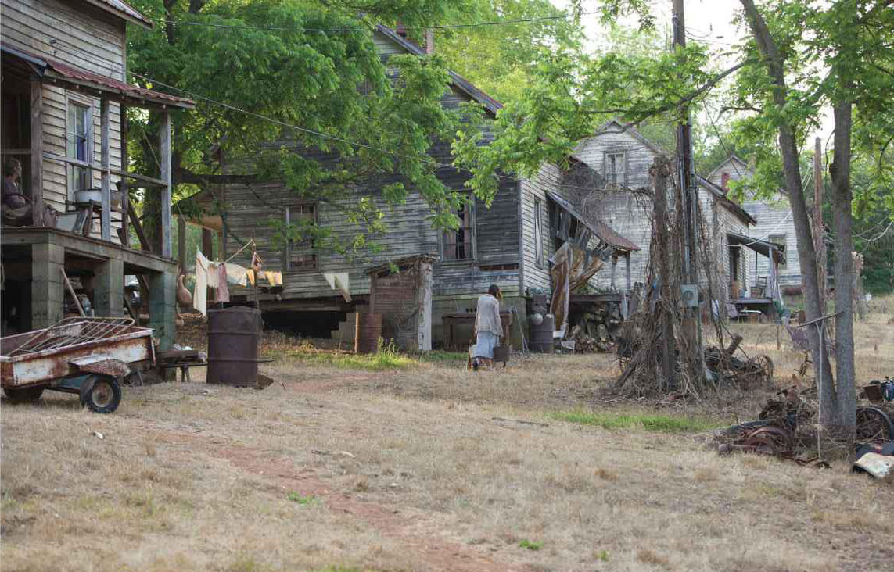
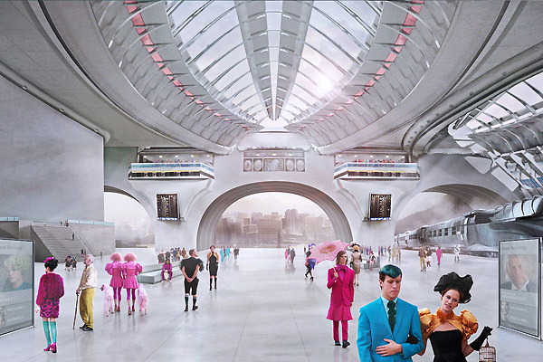
#2. Visual Contrast
District 12 vs. The Capitol in The Hunger Games
Compare the clothes, colours , body language and the surroundings of District 12 to The Capitol. What does this visual contrast tell us ?

Slide 6
Foreshadowing
Foreshadowing is a literary device in which a writer gives an advance hint of what is to come later in the story.
Example:
Batman Begins: The Calling Card
Source: http://literarydevices.net/foreshadowing/

Slide 7
Dramatic Irony
A discrepancy between expectation and reality
The audience knows something that a character is unaware of
Shawshank Redemption Escape

Slide 8
Pathetic Fallacy
Pathetic fallacy is a literary device which uses the weather to reflect a character’s emotions
The writer makes a connection between human emotion and the appearance of the landscape or the behaviour of the weather
The word “pathetic” in the term is not used in a derogatory sense of being miserable: instead it stands for “imparting emotions to something else” (the environment shares human emotions)
This is a type of Personification.
Source: http://literarydevices.net/pathetic-fallacy/

Slide 9
Examples of Pathetic Fallacy
What is the mood? How does the weather or nature contribute to the mood? What about sound effects?
Macbeth Opening Scene
Jane Eyre Opening Scene
Stepford Wives Opening Scene

