Slide 1
Using Research and Evidence
Online Writing Lab
Purdue University
https://owl.english.purdue.edu/owl/resource/588/02/

Slide 2
What type of evidence should I use?
There are two types of evidence.
First hand research is research you have conducted yourself such as interviews, experiments, surveys, or personal experience and anecdotes.

Slide 3
Second hand research is research you are getting from various texts that has been supplied and compiled by others such as books, periodicals, and Web sites.

Slide 4
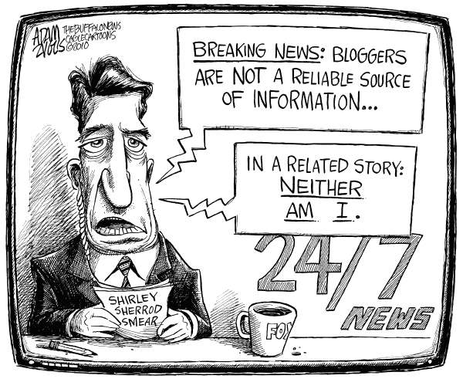
Regardless of what type of sources you use, they must be credible. In other words, your sources must be reliable, accurate, and trustworthy.

Slide 5
How do I know if a source is credible?
You can ask the following questions to determine if a source is credible.
Who is the author? Credible sources are written by authors respected in their fields of study. Responsible, credible authors will cite their sources so that you can check the accuracy of and support for what they've written. (This is also a good way to find more sources for your own research.)

Slide 6
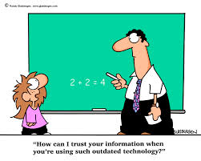
How recent is the source? The choice to seek recent sources depends on your topic.
While sources on World
War 2 may be decades old
and still contain accurate
information, sources on
information technologies, or
other areas that are
experiencing rapid changes,
need to be much more current.

Slide 7
What is the author's purpose? When deciding which sources to use, you should consider
the purpose or point of view of the author
Is the author presenting a neutral, objective view of a topic?
Is the author advocating one specific view of a topic?
Who is funding the research or writing of this source?
A source written from a particular point of view may be credible; however, you need to be careful that your sources don't limit your coverage of a topic to one side of a debate.

Slide 8
Be especially careful when evaluating Internet sources! Never use Web sites where an author cannot be determined, unless the site is associated with a reputable institution
a respected university,
a credible media outlet,
government program or department,
or well-known non-governmental organizations.

Slide 9
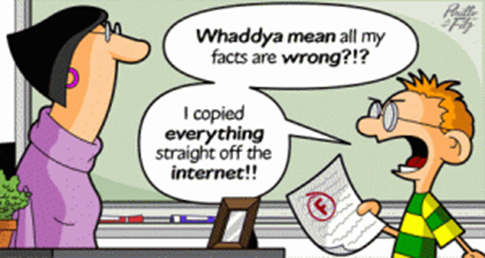
Beware of using sites like Wikipedia, which are collaboratively developed by users. Because anyone can add or change content, the validity of information on such sites may not meet the standards for academic research.

